Slide 1
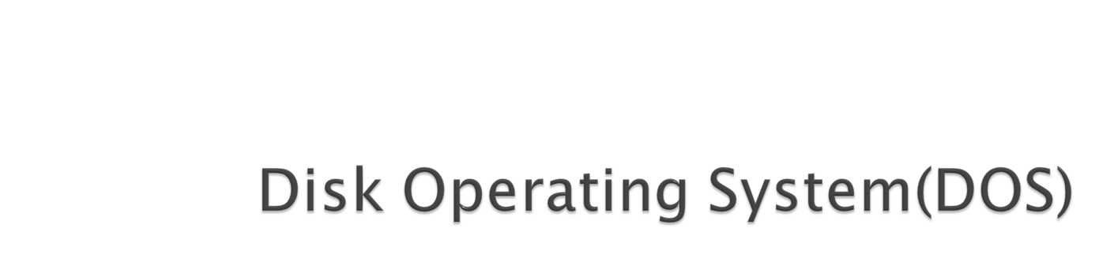

Slide 2

MS-DOS is an acronym for MicroSoft Disk Operating System
It is a CUI based operating system.
It provides user with a command prompt (generally called as C:\) where various command could be typed.
When one operates in the DOS environment, one interacts with the command interpreter, which interprets the commands given by user.
It provides an environment for execution of various application programs like MS-Word, MODBANKER, ISBS etc.
Introduction to Computers

Slide 3

It is a string of characters which tells the computer what to do.
When one types commands to a computer, one is conversing with the operating system's command interpreter.
For example, to copy a file called file.txt from the 3-1/2" floppy drive to the hard drive, one could type
C:\> copy a:\file.txt c:\
The word "copy" is a DOS command which causes files to be copied from one location to another
Introduction to Computers

Slide 4

If the OS is DOS then the system will directly show prompt (C:\>)
If the OS is windows one must either terminate the Windows environment, or open a DOS shell within the Windows environment.
Ist Method: Terminating Windows Environment
Select “Restart in MS-DOS Mode” from Shut Down in Start Menu.
IInd Method: Opening DOS Shell in Windows
Select Start>Programs>Accessories>Command Prompt (XP)
Start>Programs>Accessories>MS-DOS Prompt (98)
Introduction to Computers

Slide 5

Files
A file is a collection of Records.
It is the smallest unit of File System (Storage) in a computer.
Any document created using computer is a file. This document could either be a letter, any excel sheet, any image or even a database.
Directory
A collection of files is directory (in DOS) or folder (in Windows)
It is analogous to the Office Folder which contains various documents.
A directory/folder eases the management of related files/ documents, like the various circulars related to personnel could be placed in a directory called “personnel” and all the circulars related to loans could be placed in a directory called “loans”.
Introduction to Computers

Slide 6

The filename in DOS have the following format.
<name>.<ext>
It has two parts the name and the extension.
The name could be of 8 characters and the extension of 3 characters.
The filename can contain alphabets and numbers. It cannot contain any special character other than underscore (_) and also no spaces.
Introduction to Computers

Slide 7

  The DOS file system is a hierarchical file system.
  Files are collected into directories, and directories may contain both files and other directories.
  There is always a directory which is not contained by any other, called the root which is represented by the backslash '\' character.
Introduction to Computers

Slide 8

  Concept of Path: Every file can be specified by enumerating all of the directories between the root and it, separated by the backslash '\' character, and appending the file name to the end.
  The drive which contains the root is specified at the head of the path, separated from the root by a colon (':')
  The hard drive is most commonly known as the C: drive, and the floppy drives are usually called A:(3-1/2 inch) and B: (5-1/4 inch).
Introduction to Computers

Slide 9

dir: Listing of all the directories.
C:\> dir
cls: Clears the screen.
C:\> cls
copy con: Creates a file.
C:\> copy con <filename>
< Write your Contents Here>
Press Ctrl-Z (^Z) to finish writing.
Ex: C:\> copy con test.dat
Lets Make UCO a top class Bank.
Ctrl-Z (^Z)
1 file(s) copied. (A Message will be shown on the system)
This will create a file named test.dat having some data.
Introduction to Computers

Slide 10

edit: Edits a file.
C:\> edit <filename>
This will open a editor window where the contents of file can be seen. These contents could also be edited here and on saving, the contents of file will change.
type: Displays the content of a file.
C:\> type <filename>
This will display the contents of file on the computer. The contents of file could only be viewed but could not be changed, as in the case of edit.
Introduction to Computers

Slide 11
md: Make Directory.
C:\> md (directory name>
This will create a directory with the specified name.
cd: Change Directory.
C:\> cd (directory name>
This will change the directory from current directory to the specified directory.
rd: Remove Directory.
C:\> rd (directory name>
If the directory is needed to be removed permanently from the computer, use this command. For this command to be executed it is necessary that the directory should be empty and user should be on a directory above it.
Introduction to Computers

Slide 12
copy: Copies a file.
C:\> copy <source> <destination>
This will copy the file from the source location to the specified destination. The command creates a copy of the file on the destination i.e. the file would be found on both the location.
move: Moves a file.
C:\> move <source> <destination>
This will move the file from the source location to the specified destination. The file from the source location would be removed and would be moved to the destination.
Introduction to Computers

Slide 13

ren: Renames a file.
C:\> ren <old filename> <new filename>
This will change the name (rename) of the file to a new name as specified.
del: Deletes a file.
C:\> del <filename>
This will delete the file permanently from the system.
Introduction to Computers

